Slide 1
Single Image Motion Deblurring Using Transparency
Team: ProximaCentauri
Abhinaba Bala(2020701001), Neel Mishra(2020701009),
Ritam Basu(2020701005), Jigyasu Khandelwal(2020702013)
Mentor TA: Soumyasis Gun
Repo URL : https://github.com/Digital-Image-Processing-IIITH/project-proximacentauri/

Slide 2
Contents
Motivation
Previous Work
Overview
Understanding the problem
Transparency
Analysis of blur
Alpha Matte
Optimization
Lucy-Richardson
Limitations
References

Slide 3
Motivation
One of the key problems of restoring a degraded image from motion blur is the estimation of the unknown shift-invariant linear blur filter.
In this work the image deblurring is separated into filter estimation and image deconvolution processes.

Slide 4
Previous Works
With unknown linear shift-invariant PSF, early approaches usually assume a priori knowledge to estimate the blur filter in deblurring the input image.
Recent approaches propose a variational Bayesian approach using an assumption on the statistical property of the image gradient distribution to approximate the unknown blurred image.

Slide 5
Overview
Motion blur is a phenomena which is caused by the movement of object or camera shake at the time of triggering of camera shutter.
The paper proposes a way to deblur the image.
It is done by proposing a model for motion blur using transparency.

Slide 6
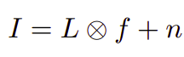
Understanding the problems
The previously proposed model for image deblurring are mainly centred on solving an equation
The main concern regarding restoring a still image containing motion blur is that the background may not undergo the same motion blur.
The notion of transparency will help in resolving this.

Slide 7
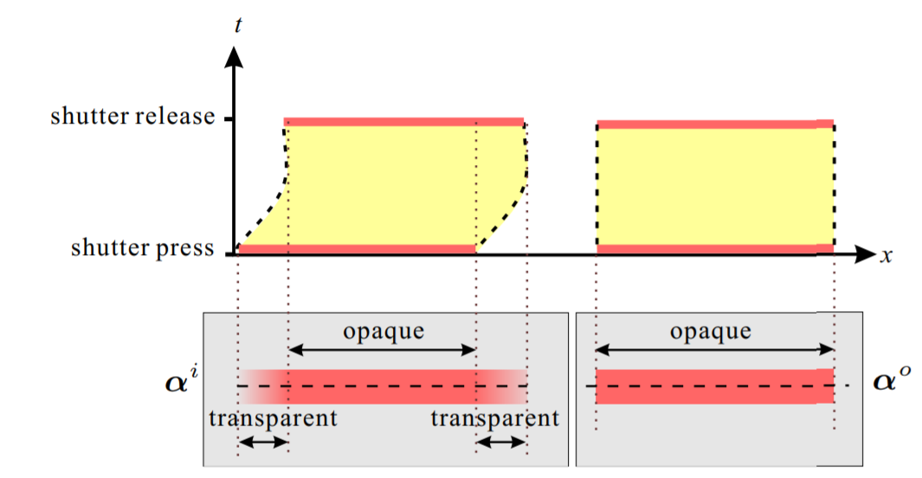
Where does transparency come in?
Transparency is the proportion of time
that the background is exposed.
We use transparency to model the blur
filter.
defines transparency corresponding
to blurred image pixels.
defines transparency values
corresponding to non blurred image pixels.

Slide 8
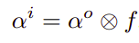
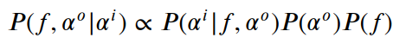
Analysis of object motion blur
A formulation of motion blur from transparency point of view can be given as:
A MAP approach is proposed to recover the motion blur filter using transparency.
Using Bayes rule:

Slide 9
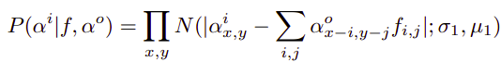
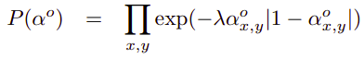
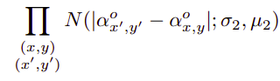
Analysis of object motion (cont)
The likelihood measures the similarity between the input and convolved alpha values.
And the prior is taken to be:

Slide 10
Generalised Transparency In Motion Blur
The aim here is to estimate the blur filter due to camera shake.
The entire image is not required to be taken into computation.
Considering the alpha blending of background and foreground colors, we obtain that we have to compute the same blur filter as we did before.

Slide 11
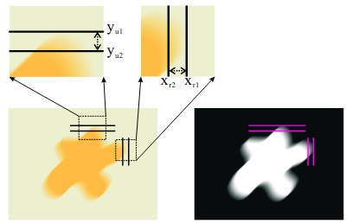
Upper bound for the filter size
Using transparency allows one to automatically detect an upper bound for the filter size.
The image shown on the left is the blurred object while the image on the right is the corresponding transparency map.

Slide 12
Upper bound for the filter size
Max Width = X1 - X2 + 1
Max Height = Y1 - Y2 + 1

Slide 13
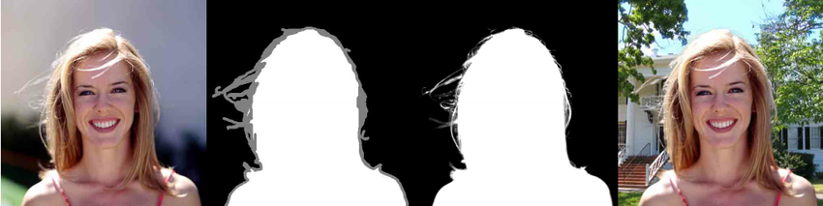
Alpha Matte

Slide 14
Alpha Matte
Our work starts with estimating the foreground and background regions, as well as the foreground opacity which is called alpha matte.
In the given paper, the authors employ methods from “A closed form solution to natural image matting. 2006” paper to estimate this region.
The aim is to minimize the matting Laplacian subject to scribbled constraints.

Slide 15
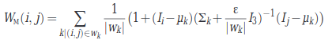
Matting Laplacian
For intuition, consider an image patch with two colours. The affinity between two pixels of the same colour decrease with distance, while the affinity between pixels of different colours is zero.
Matting affinity uses local estimates of means and variance.

Slide 16
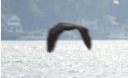


Alpha Matte results
Original Image:
Our scribbled matte prior:
Output Matte:

Slide 17
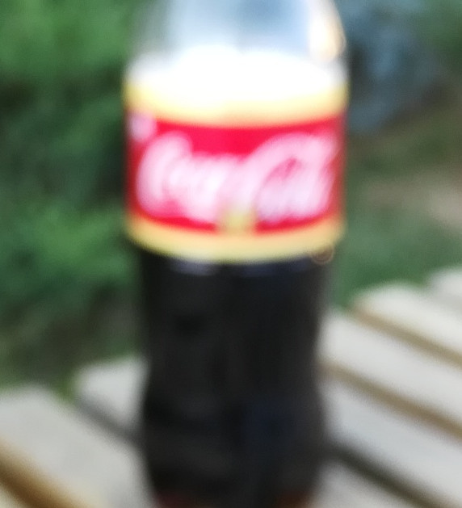
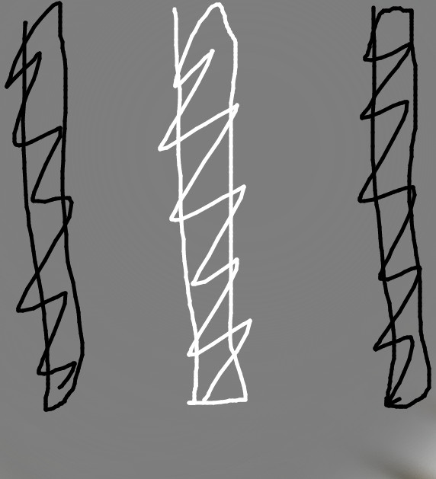
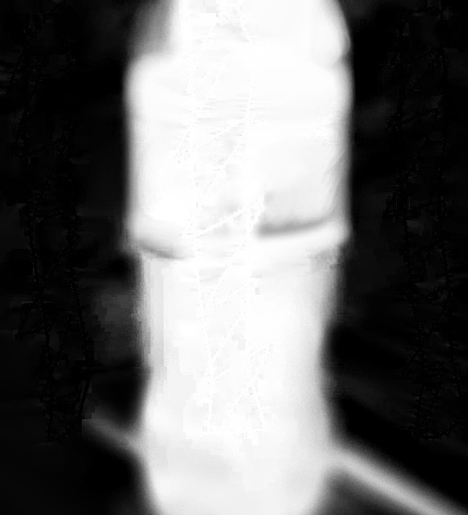
Alpha Matte results
Original Image:
Our scribbled matte prior:
Output Matte:

Slide 18
Limitations in Matte estimation
The alpha values are distorted for very intricate details along with inability to completely mark the priors.
The alpha values are wrongly learned if the foreground image has minimal contrast with the background.
In some cases the prior remained as the new alpha values without any learning.

Slide 19
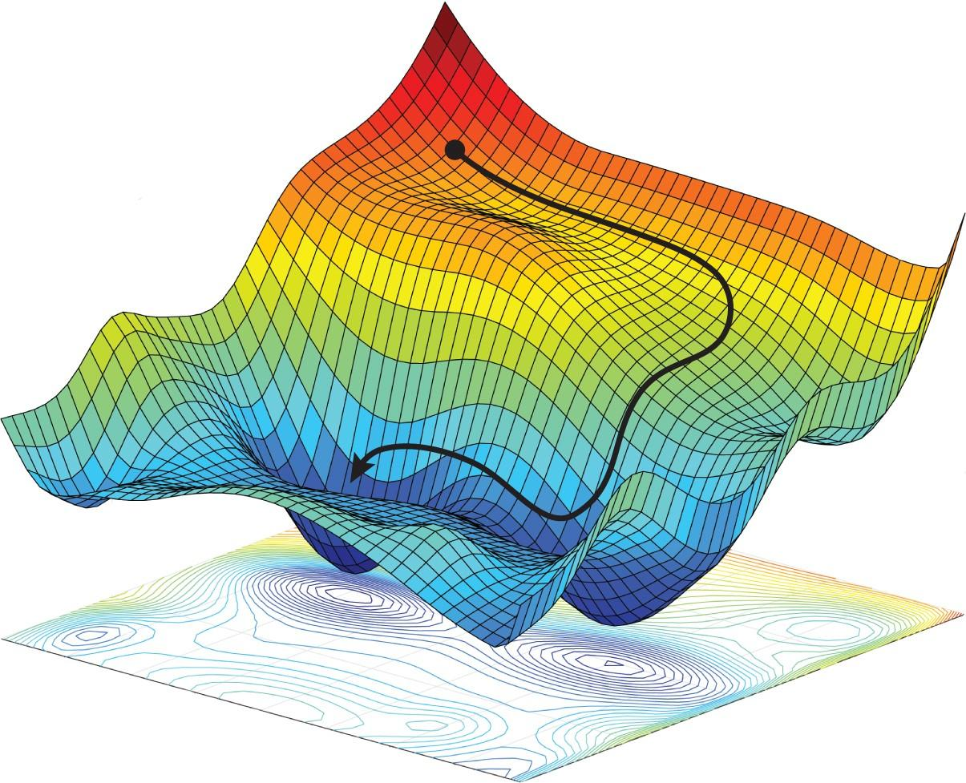
Optimization :-

Slide 20
Optimization in paper
The author has used conjugate gradient descent, and belief propagation to estimate blur filter.
Here we have used only the gradient descent method.
The sklearn has the conjugate gradient descent built in but it provides very less control in the process.
Hence we decided to go with our implementation of gradient descent.

Slide 21
Optimization
We have to perform MAP optimization on the above equation.
is a constant entity.
is defined from a uniform distribution.
is the likelihood.

Slide 22
Patch Optimization :-
Optimized on patches, rather than optimizing on the entire image.
We can divide the image in patches, one heuristic that can be applied is to target those region where the alpha values are between 0 and 1.
This allows for speedy optimization, and better results as we can choose better hyper parameters in relatively less time.

Slide 23
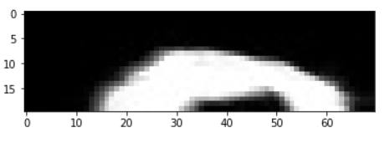
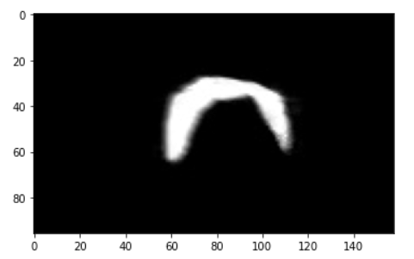
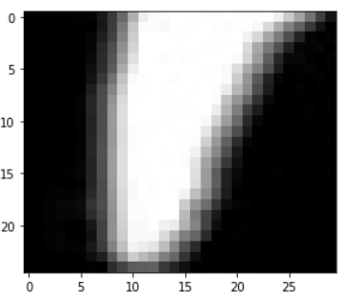
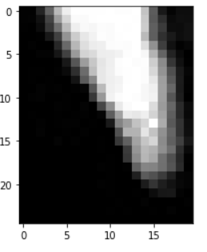
Original Image
Patches taken

Slide 24
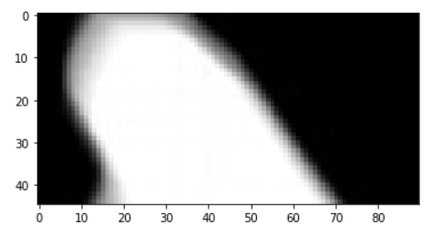
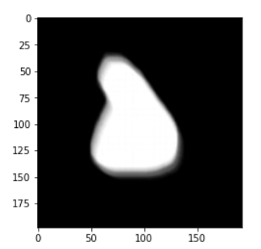

Original Image
Patches taken

Slide 25
Optimization Process :-
For each patch repeat :-
Set the filter size.
Initialize filter (random, all ones, all zeros)
Perform gradient Descent
Perform lucy richardson on the patch with the optimized filter.
Store the desired output in an array to later combining it.
Stitch all the patches back to form one complete image.

Slide 26
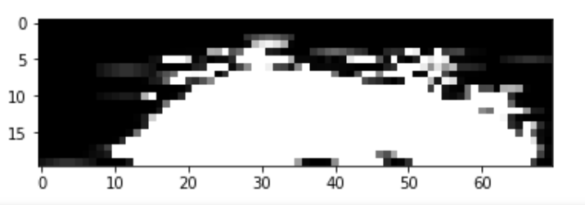

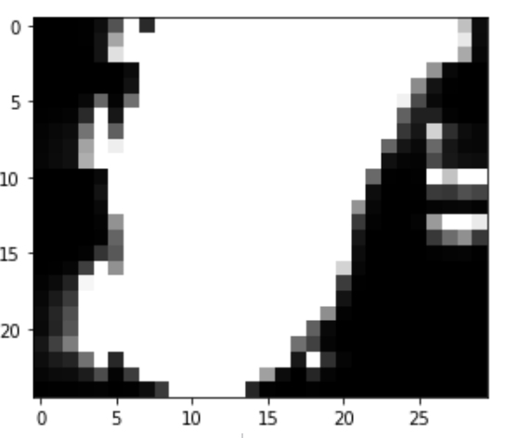
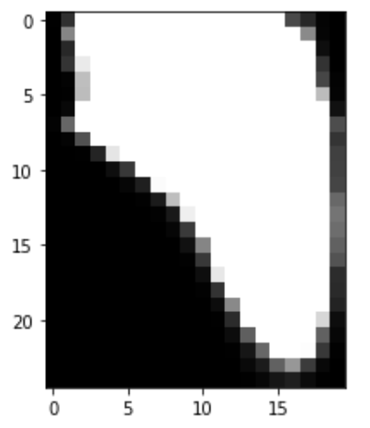

Output

Slide 27
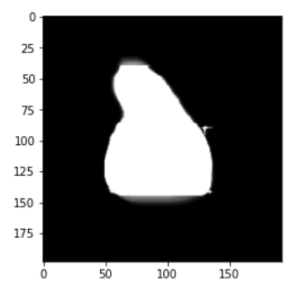
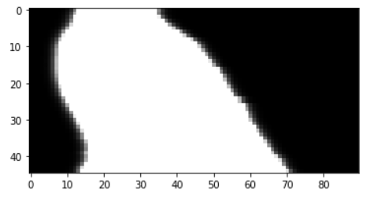
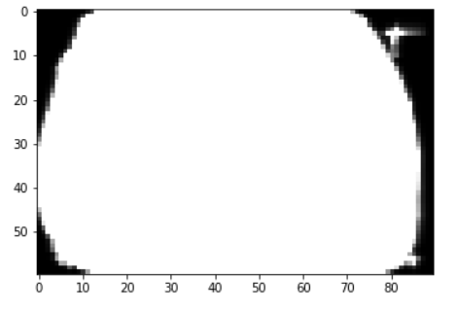
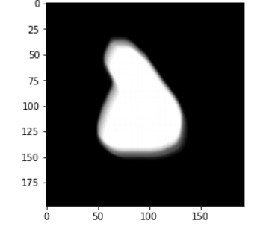

Slide 28

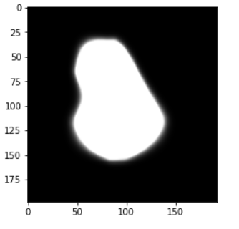
Why don’t we optimize on full image?

Slide 29
Why don’t we optimize on full image?
It takes a lot of time to learn the filter.
Fiddling with hyperparameter becomes tedious due to large execution time.
Output is not as appealing as that with patches.

Slide 30
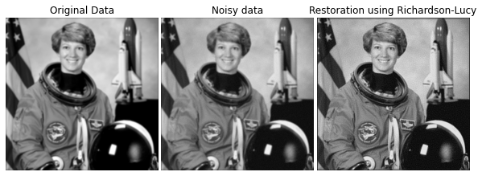
Deconvolution-Lucy Richardson
The Richardson–Lucy algorithm, also known as Lucy–Richardson deconvolution, is an iterative procedure for recovering an underlying image that has been blurred by a known point spread function.

Slide 31
Lucy Richardson algorithm
The LR algorithm is best understood if we first consider a simple iterative algorithm and then see how the LR method is an extension of this approach.
As modelled earlier the blurred image is a convolution of unknown filter and unblurred image, if the noise is also considered:
Where ‘**’ represents convolution g(x,y) represents the output blurred image n(x,y) represents noise f(x,y) represents the input image and h(x,y) represents point spread function.

Slide 32
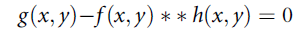
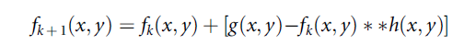
Equation proposed can be rewritten as
If we consider a good estimate then noise would be small
Now if we add f(x,y) both the sides
Hence the final iterative model is

Slide 33
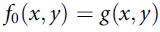
The procedure described by above equation is started by setting
Hence the first estimate of the input distribution is considered to be the measured output. Unless the image is very severely degraded, the output is not hugely different from the true input distribution and this simple procedure converges nicely.
The Equation can never be satisfied exactly, unless there is no noise at all, but will reach a point at which the size of the correction term in Equation reaches a minimum value.

Slide 34
The basic assumptions made in lucy richardson method are:
It is assumed that point spread function is known. And hence in proposed function for lucy richardson algorithm point spread function is fed by the user.
We assume that the noise at the output is governed by poisson distribution function.

Slide 35
Limitation of Lucy-Richardson
The limitation of lucy_richardson algorithm is that the output may depend upon the number of iterations employed.
Another limitation is that if the point spread function is constant then lucy_richardson is not efficient approach to deconvolve.

Slide 36
Limitations
Patches have to be selected manually to run the optimization efficiently.
The performance drops as the amount of blur increases.
It was observed that multiple optimization algorithms have to used to get finer results.

Slide 37
Division of Work
Abhinaba
Neel
Ritam
Jigyasu
Alpha Matte
Documentation
Optimization
Documentation
Optimization
Lucy-Richardson
Lucy-Richardson
Alpha Matte

Slide 38
References
Alpha Matting: https://webee.technion.ac.il/people/anat.levin/papers/Matting-Levin-Lischinski-Weiss-CVPR06.pdf
Lucy Richardson :- A.Jain.Fundamentals of Digital Image Processing. Prentice Hall,1988.
Single image motion: http://jiaya.me/all_final_papers/motion_deblur_cvpr07.pdf

Slide 39
Thank
You

